Slide 1
CONTROL AND MONITORING OF
Unmanned Surface Vehicle for Waste Collection

Slide 2
Hardware Update

Slide 3
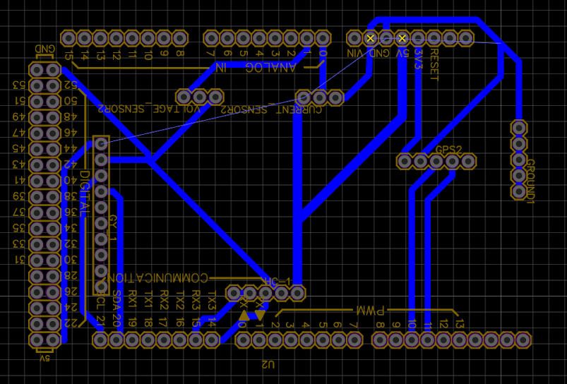
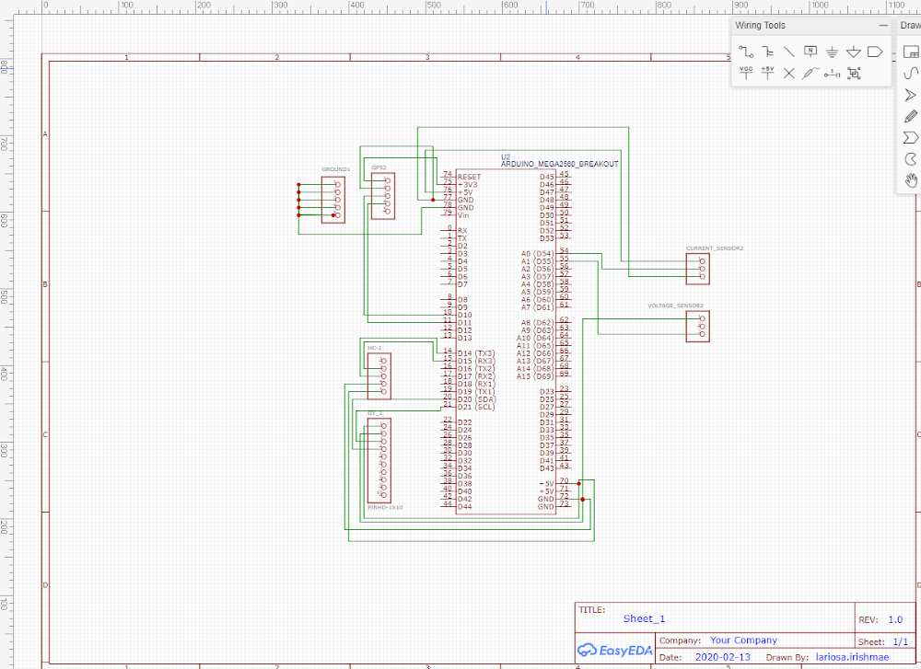
The schematic design was initially done using EagleCAD and was exported to EasyEDA. The picture below shows the schematic design for the circuit. The design shows the pin heads connected to the arduino mega 2560.
Breadboard Layout
The schematic design was then converted to the breadboard layout.
Schematic Diagram on EasyEDA

Slide 4
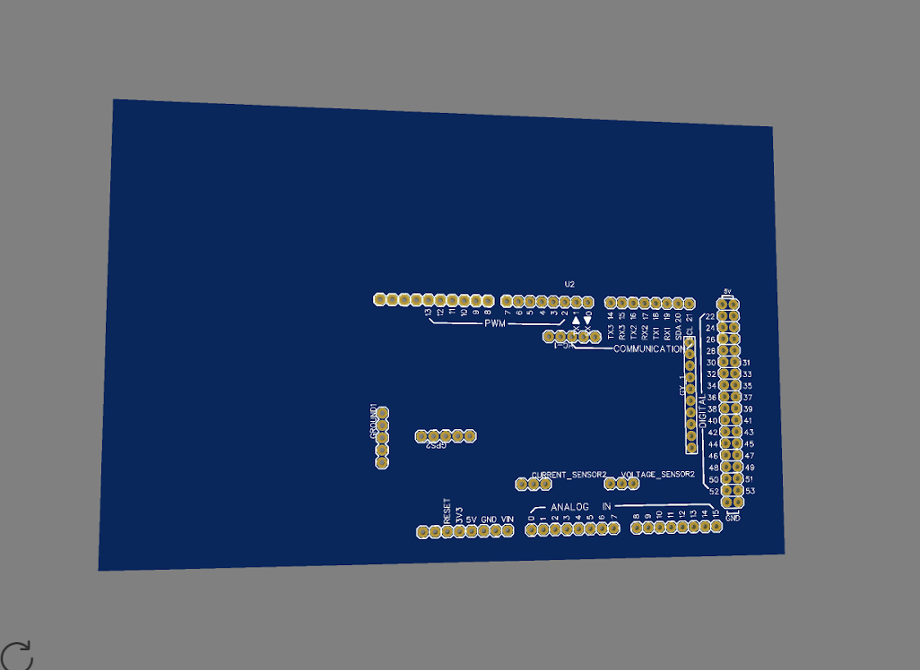
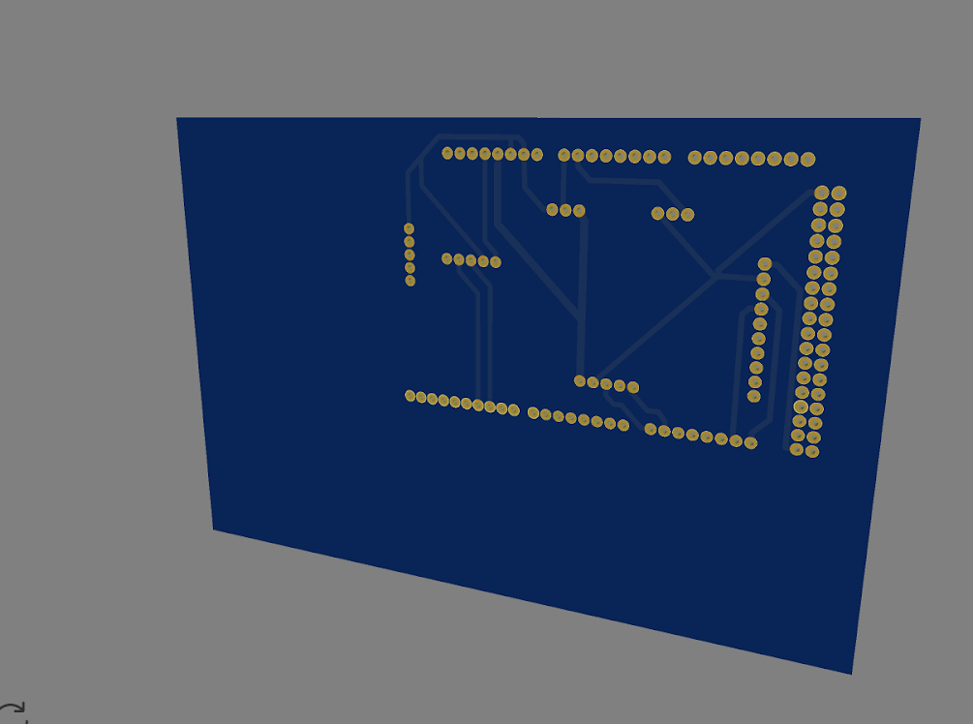
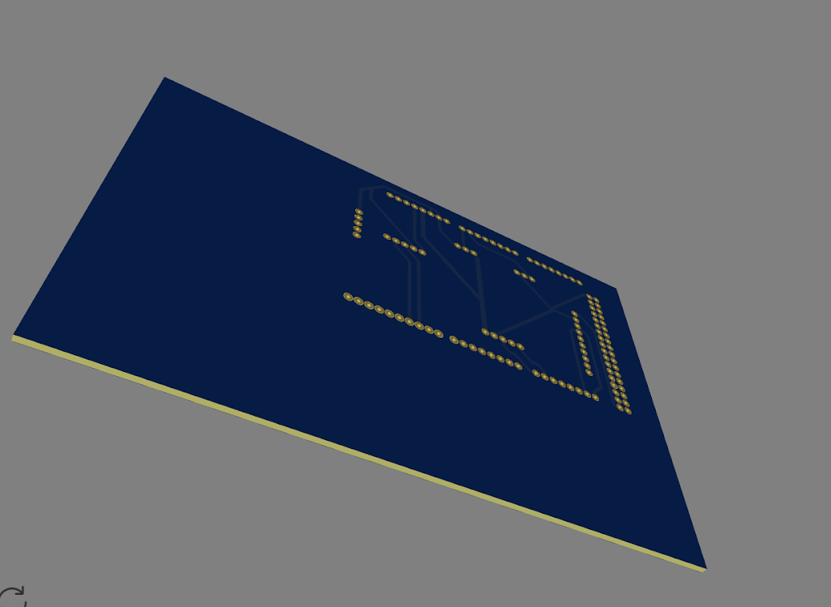
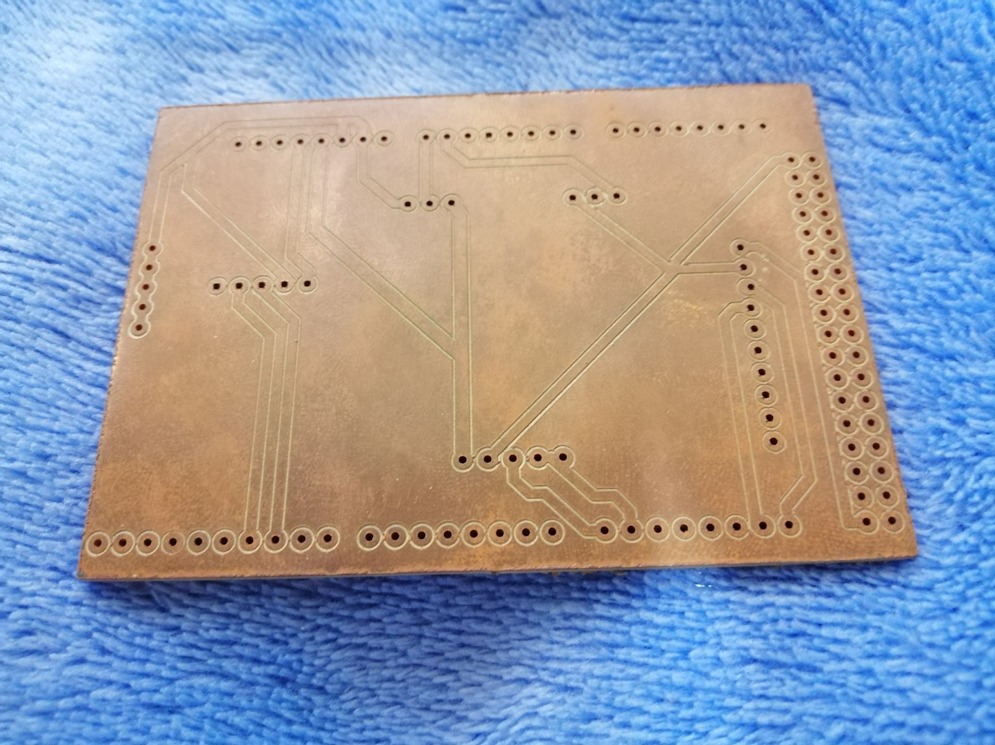
EasyEDA also provides a 3D view of the circuit layout.
The converted board layout was used to print the PCB. The researcher visited and have it printed in RF Laboratory of the Department of Electrical Engineering and Technology located in the 2nd floor building of the College of Engineering and Technology.

Slide 5
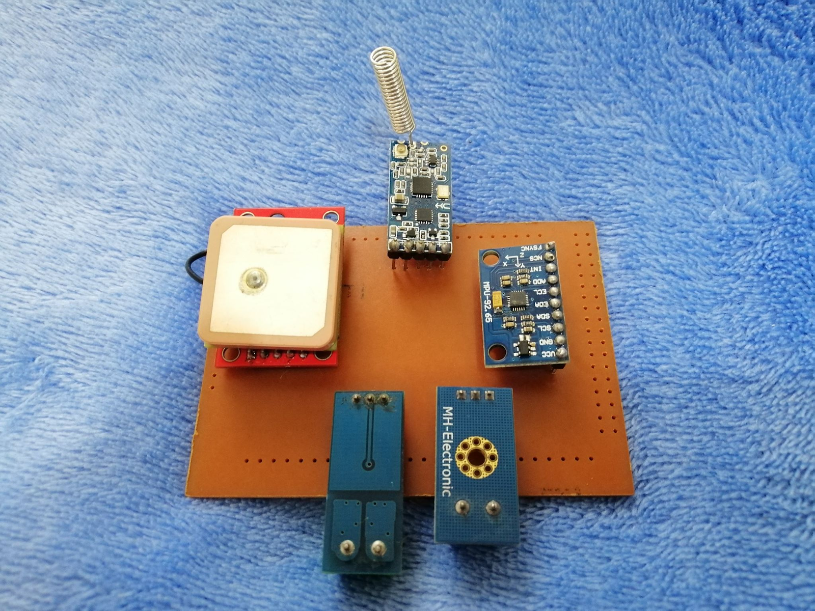
PCB and its components
Due to unforeseen events, the researchers weren’t able to solder the components on the PCB layout. The picture below shows how the PCB would like if the components were soldered.

Slide 6
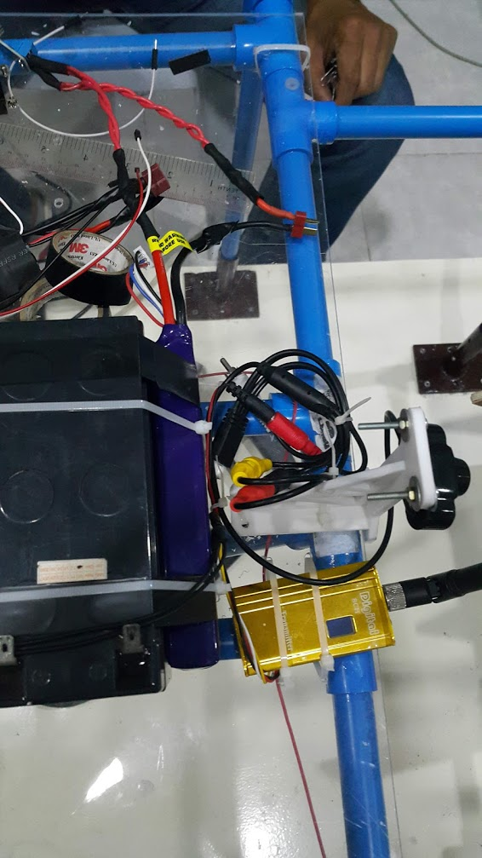
Current Wiring
For the power source of the motors, a dc-dc converter was used to regulate the voltage supplied to the motors. The researchers were able to arrange some wires on the boat for resilience to external stress. The inability to go to school and work on the lab makes the task incomplete for the meantime.

Slide 7
Software Update

Slide 8
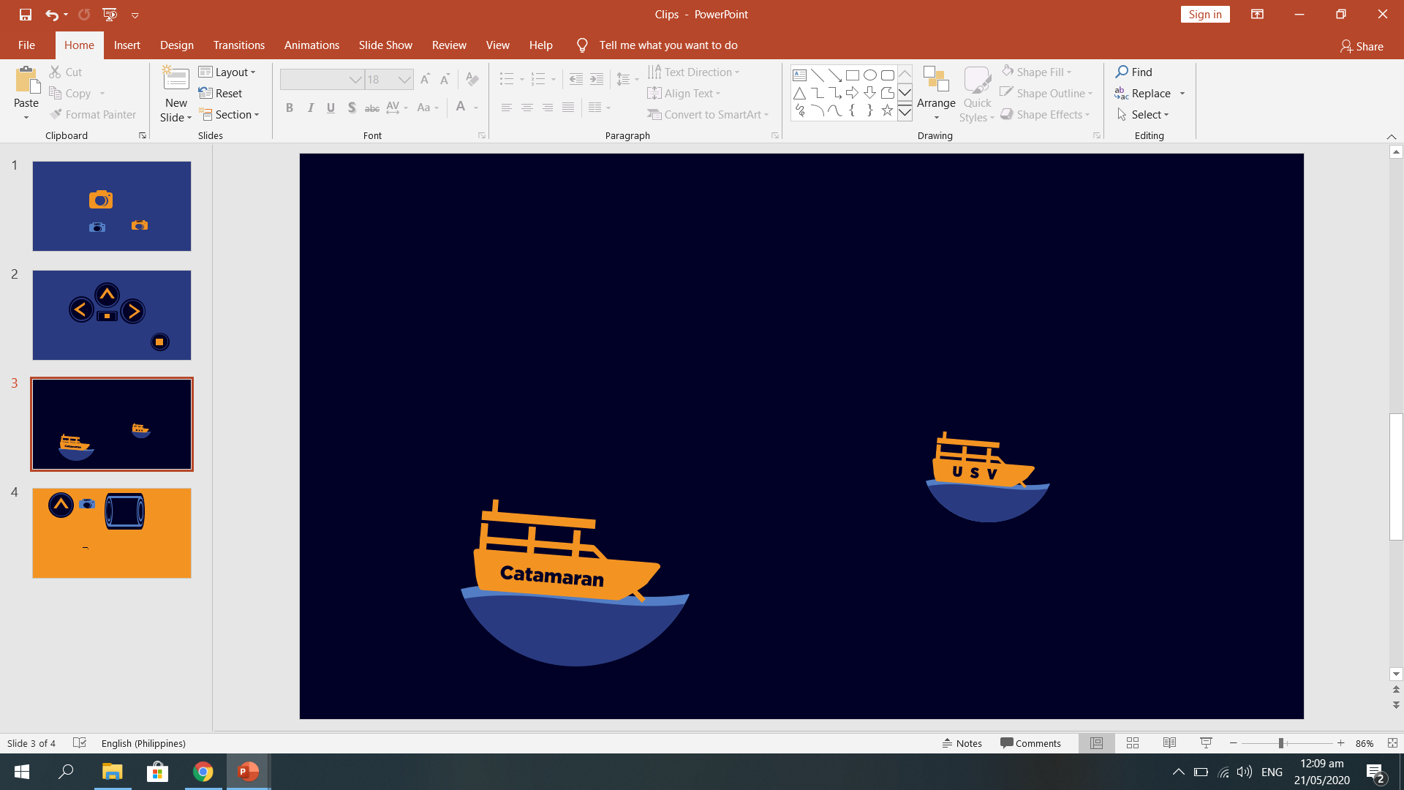
In order to make the user interface more interactive, various clips were made in PowerPoint. This is advantageous when you suddenly need to change the color theme or the size of the clips without damaging the graphics quality.
Clips that are used in user-interface

Slide 9
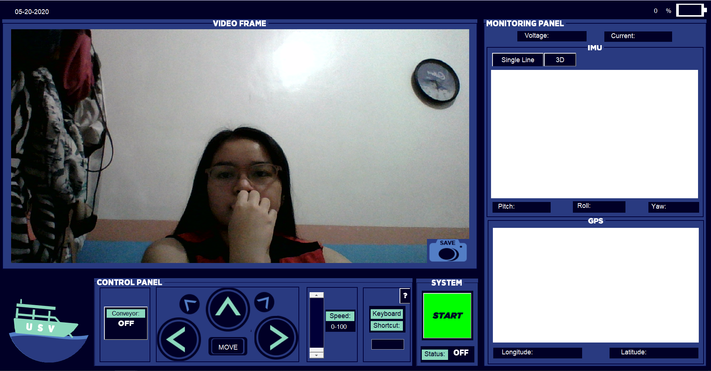
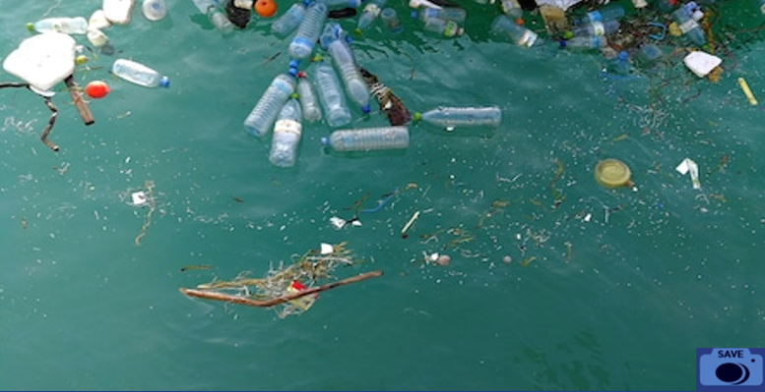
This is the User Interface (UI). To start the control and monitoring of the USV, the start button which is in green color is pressed.
The UI is mainly composed of three main panel; the video frame, monitoring panel, and the control panel.

Slide 10
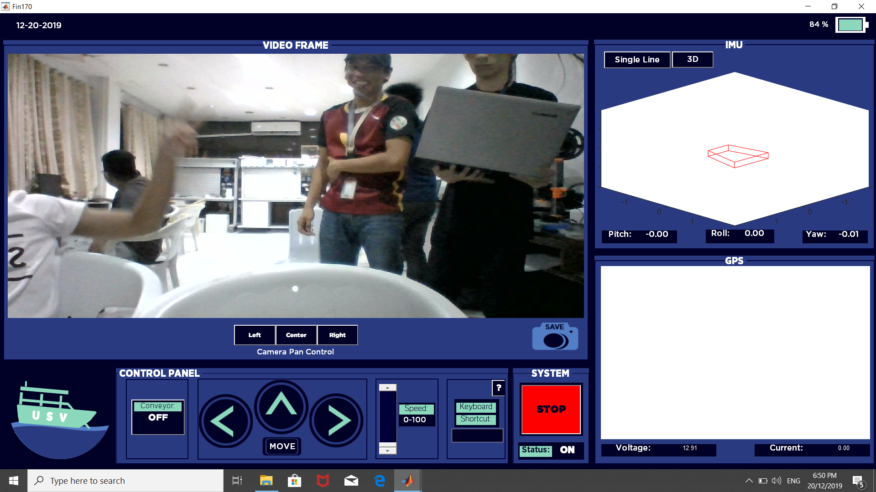
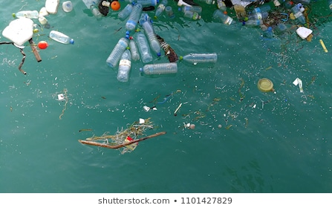
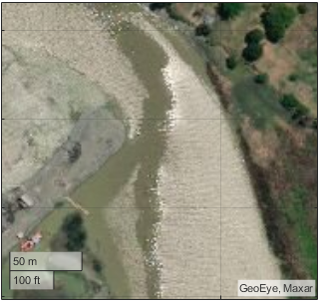
This is how the UI looks like in operation. The design and the buttons are not yet final, depending on how the tests will go after covid, changes might be necessary.

Slide 11
Firmware Update

Slide 12
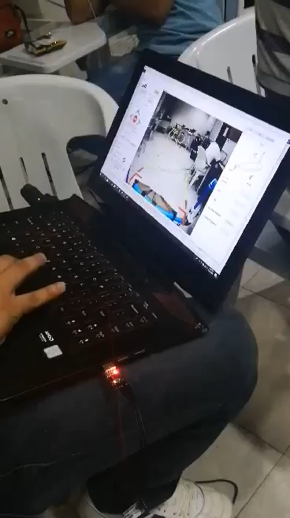
This video contains the tests made on the wireless transmission of control from MATLAB GUI to the Unmanned Surface Vehicle. Controls such as; rudder control, conveyor control, and propeller speed control can be seen from the video.
Tests were also successfully made in acquiring data from the IMU and GPS from a far distance-size of 5th floor front railings. These data were automatically saved in Excel. But unfortunately, there is not enough data to show the researcher’s results yet. Hopefully, after covid the researcher’s can continue to conduct their study.
Last Test taken before Covid

Slide 13
THANK YOU! ☺

